Slide 2
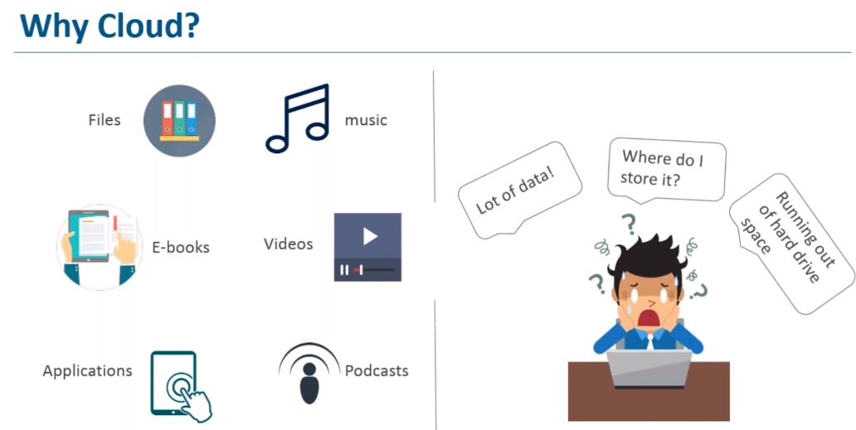

Slide 3
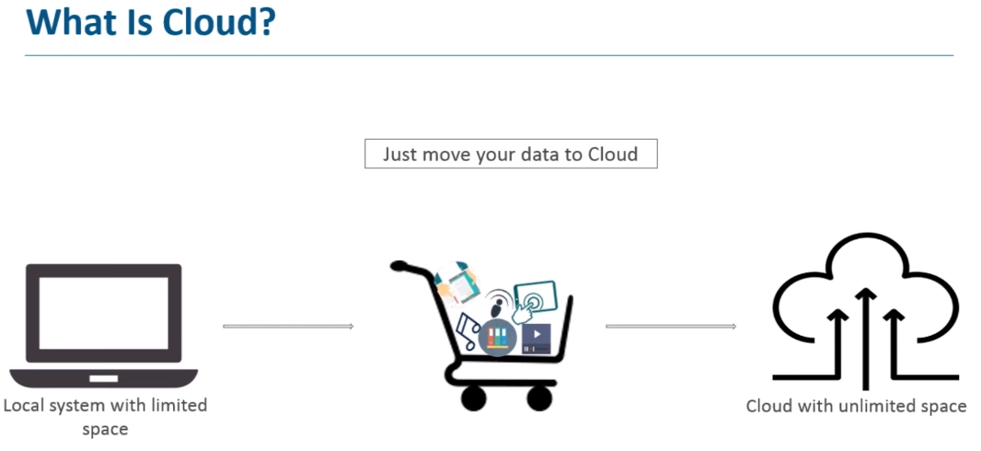

Slide 4
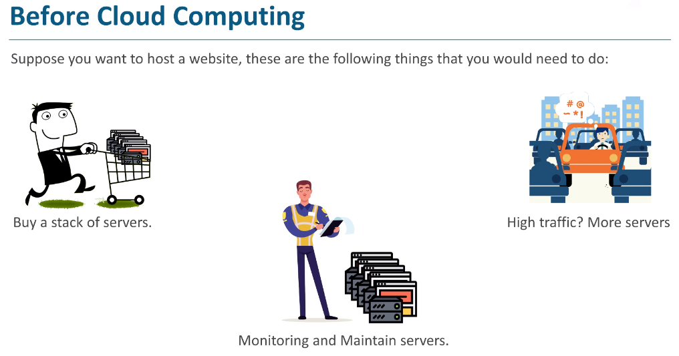

Slide 5
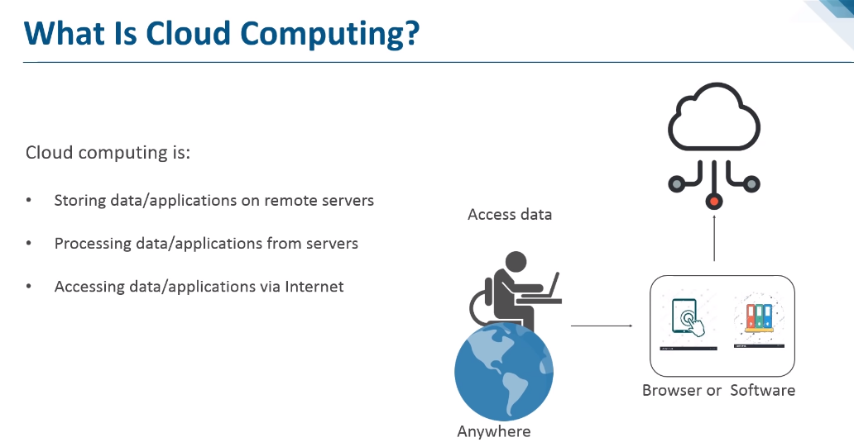

Slide 6
What is Cloud Computing?
Cloud Computing is defined as storing and accessing of data and computing services over the internet.
It doesn't store any data on your personal computer. It is the on-demand availability of computer services like servers, data storage, networking, databases, etc.
The main purpose of cloud computing is to give access to data centers to many users. Users can also access data from a remote server.
Examples of Cloud Computing Services:
AWS, Azure, Google Cloud

Slide 7
Cloud Computing basics with an example –
Whenever you travel through a bus or train, you take a ticket for your destination and hold back to your seat till you reach your destination.
Likewise other passengers also takes ticket and travel in the same bus with you and it hardly bothers you where they go.
When your stop comes you get off the bus thanking the driver.
Cloud computing is just like that bus, carrying data and information for different users and allows to use its service with minimal cost

Slide 8
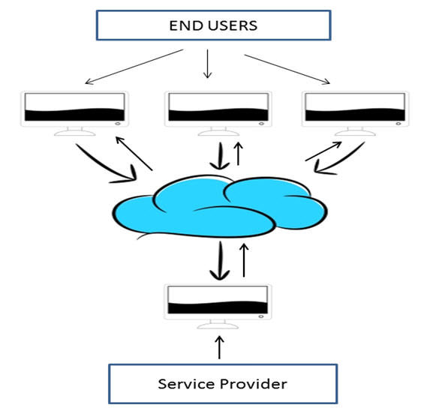
Why the Name Cloud?
The term “Cloud” came from a network design that was used by network engineers to represent the location of various network devices and there inter-connection.
The shape of this network design was like a cloud.

Slide 9
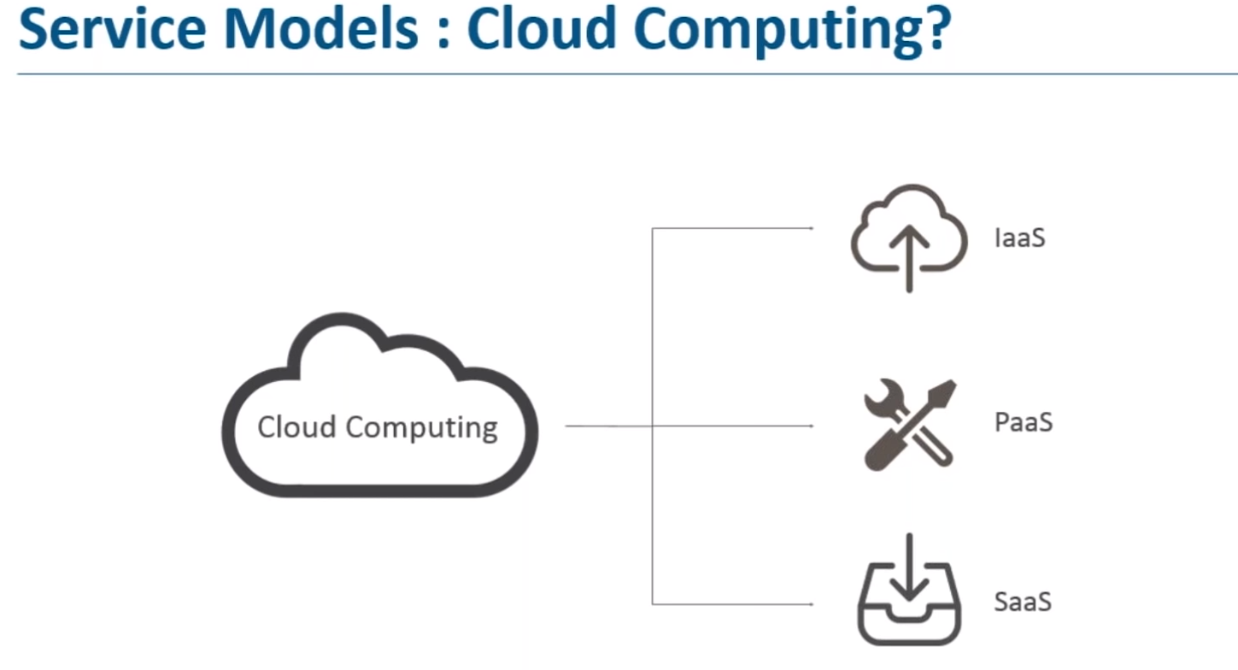
Software as a Service (SaaS)
Platform as a Service (PaaS)
Infrastructure as a Service (IaaS)

Slide 10
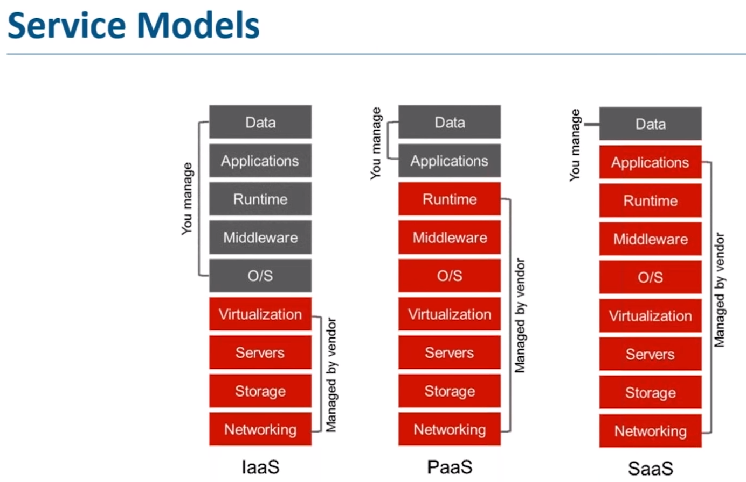

Slide 11
Infrastructure As A Service (IaaS)
It is the most flexible type of cloud service which lets you rent the hardware and contains the basic building blocks for cloud and IT.
It gives complete control over the hardware that runs your application (servers, VMs, storage, networks & operating systems).
It’s an instant computing infrastructure, provisioned and managed over the internet.
Examples of IaaS are AWS EC2, Storage or Networking. DigitalOcean, Amazon Web Services (AWS), Microsoft Azure, Google Compute Engine (GCE), Rackspace, and Cisco Metacloud.

Slide 12
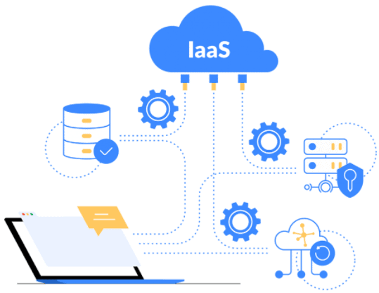

Slide 13
Platform As A Service (PaaS)
PaaS is a cloud service model that gives a ready-to-use development environment where developers can specialize in writing and executing high-quality code to make customized applications.
It helps to create an application quickly without managing the underlying infrastructure.
For example, when deploying a web application using PaaS, you don’t have to install an operating system, web server, or even system updates. However, you can scale and add new features to your services.
Examples of PaaS: Elastic Beanstalk or Lambda from AWS, WebApps, Functions or Azure SQL DB from Azure, Cloud SQL DB from Google Cloud, or Oracle Database Cloud Service from Oracle Cloud.

Slide 14
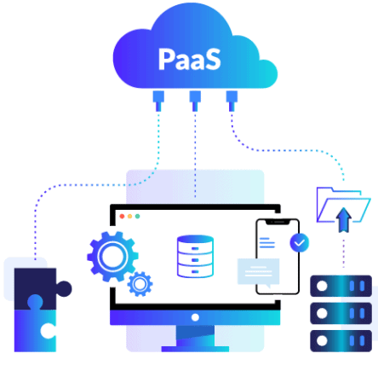

Slide 15
Software As A Service (SaaS)
SaaS provides you with a complete product that is run and managed by the service provider.
With a SaaS offering, you don’t need to worry about how the service is maintained or how the underlying infrastructure is managed. It would help if you believed how you’d use that specific software.
Examples of SaaS: Microsoft Office 365, Oracle ERP/HCM Cloud, SalesForce, Gmail, or Dropbox.

Slide 16
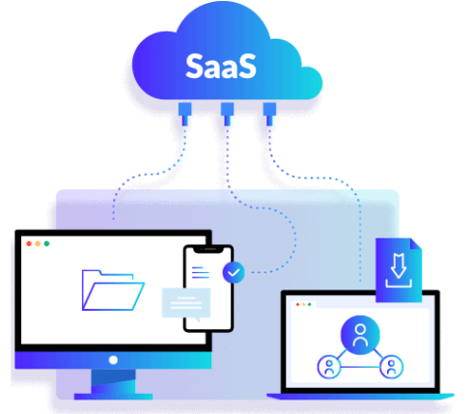

Slide 17
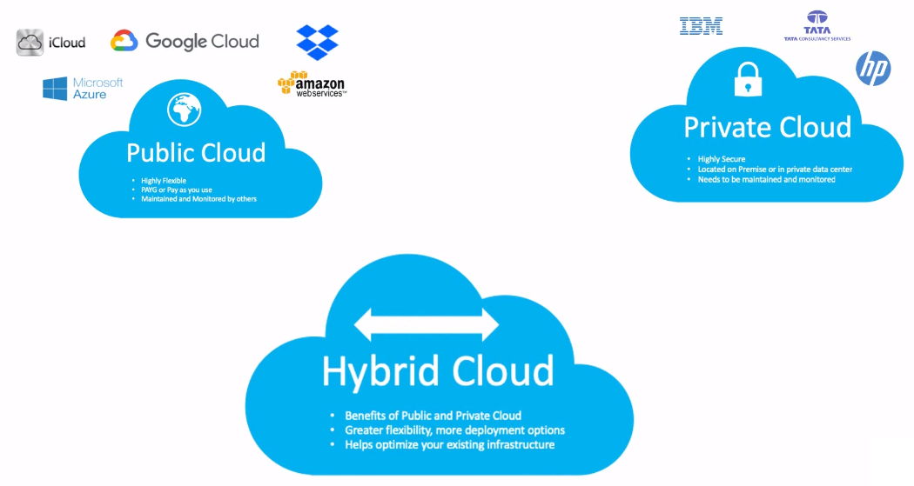

Slide 18
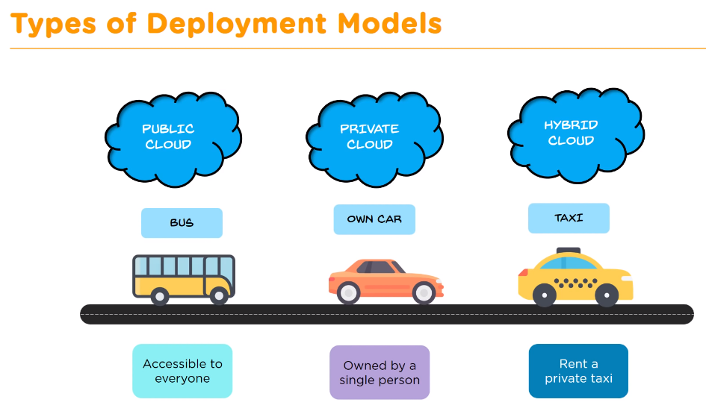

Slide 19
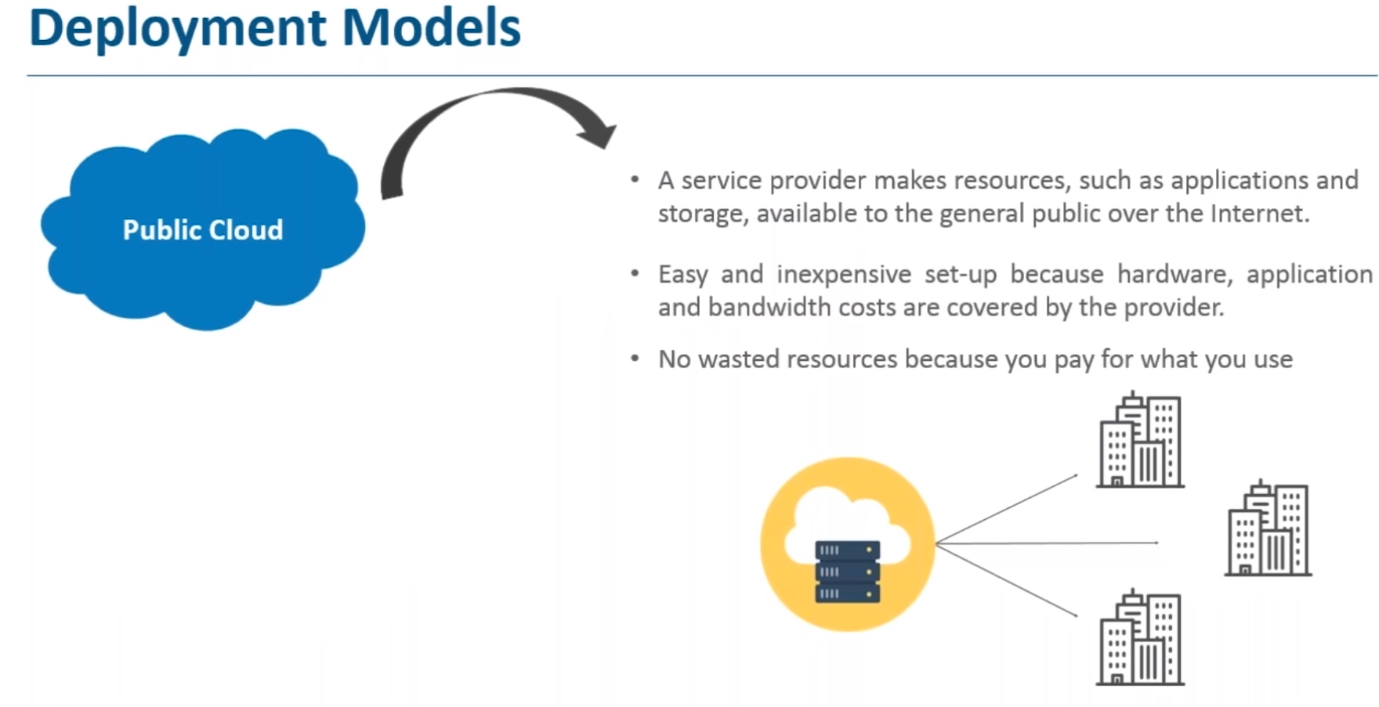

Slide 20
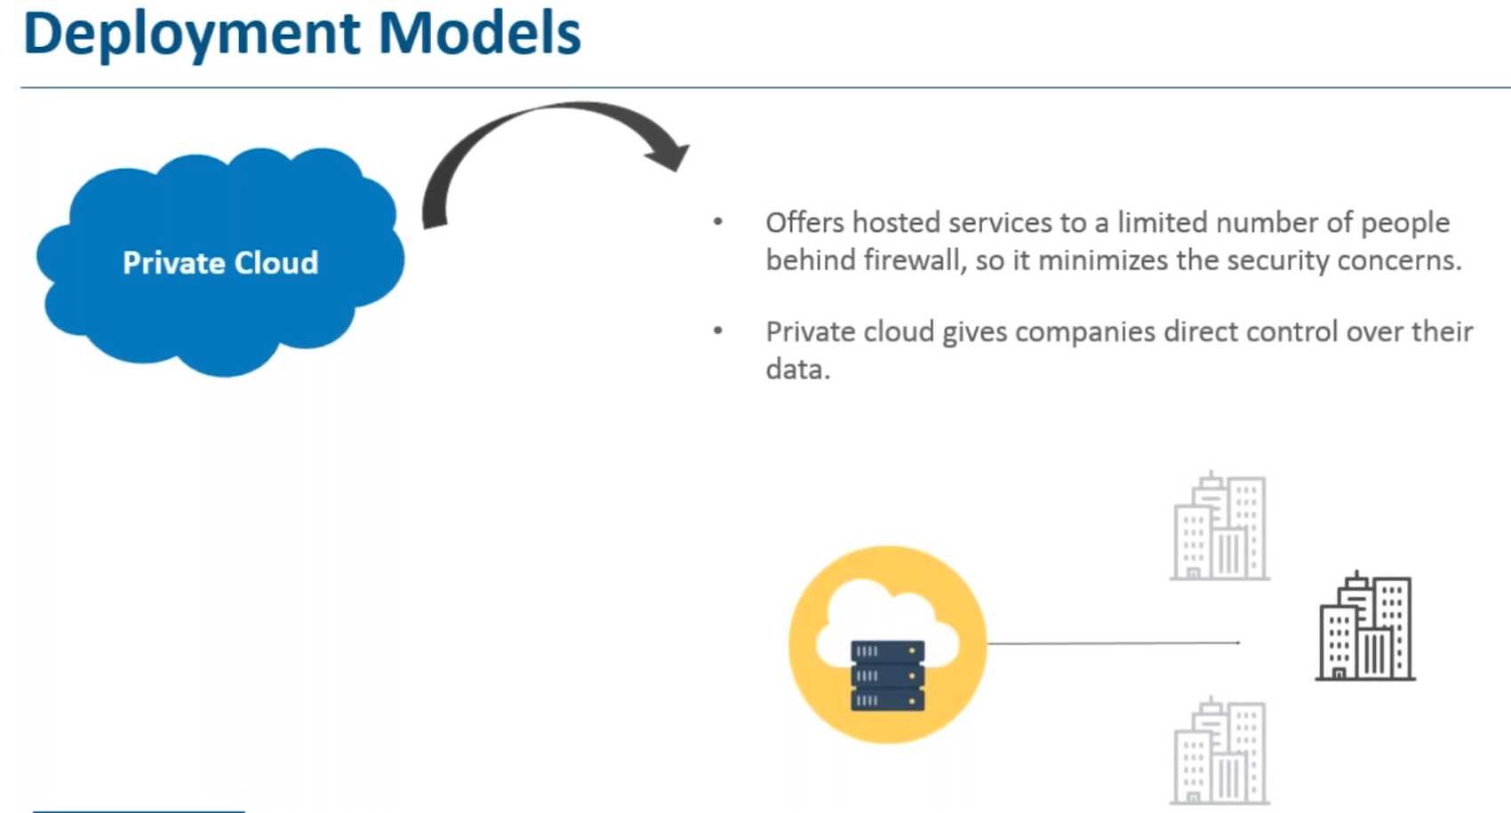

Slide 21
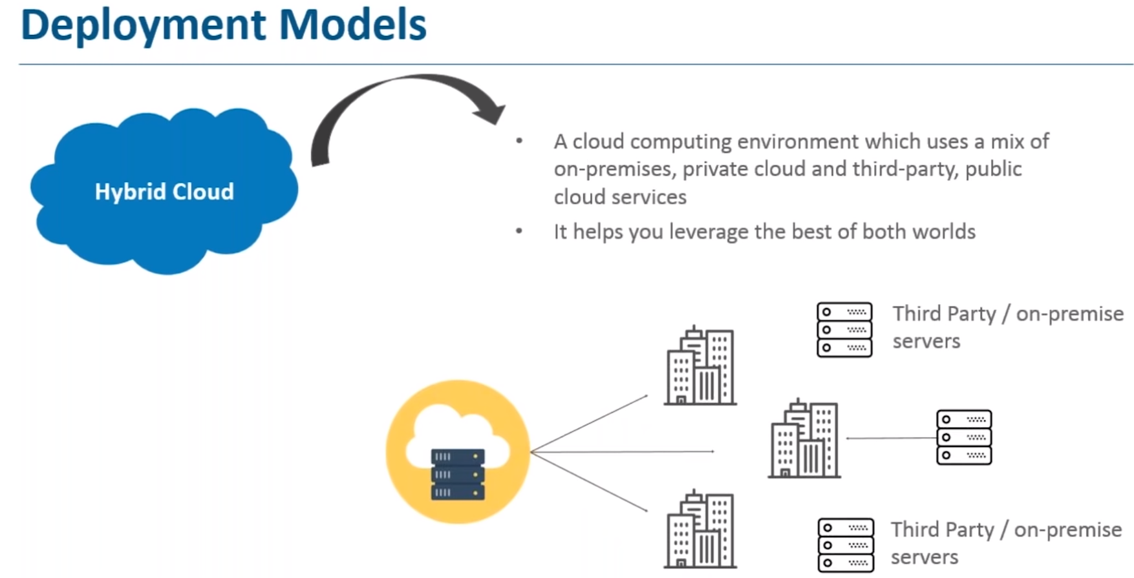

Slide 22
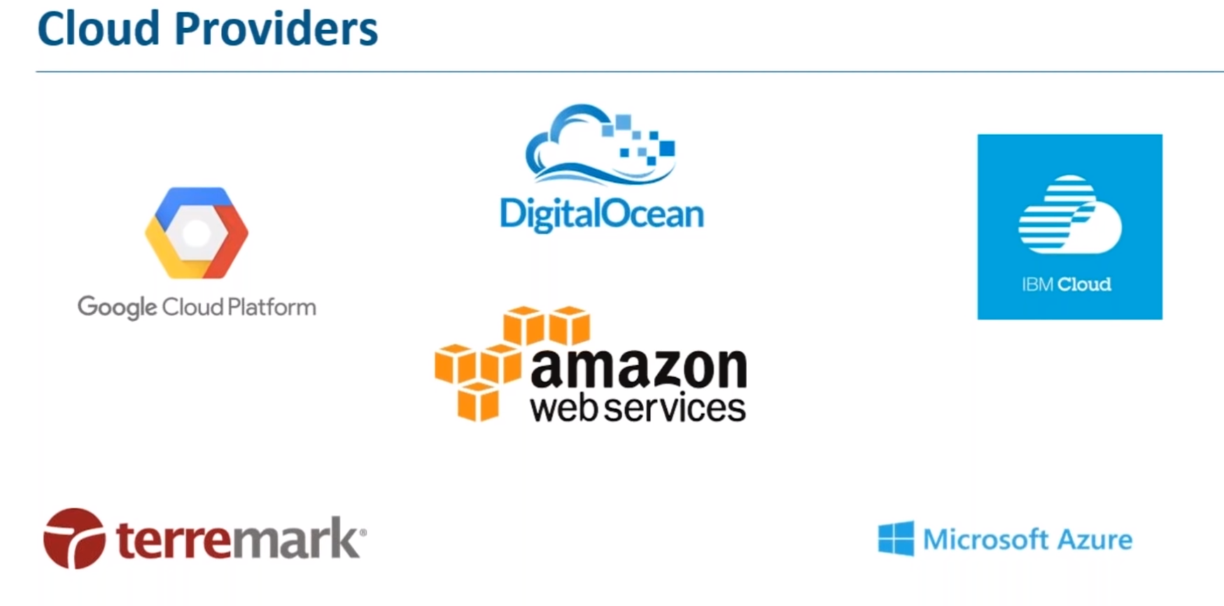

Slide 23
What is Cloud Computing Architecture?
Cloud Computing Architecture is a combination of components required for a Cloud Computing service.
A Cloud computing architecture consists of several components like a front-end platform, a back-end platform or servers, a network or internet service, and a cloud based delivery service.
Cloud computing comprises of two components front end and back end.
Front end consist client part of cloud computing system.
It comprise of interfaces and applications that are required to access the Cloud Computing or Cloud Programming platform.

Slide 24
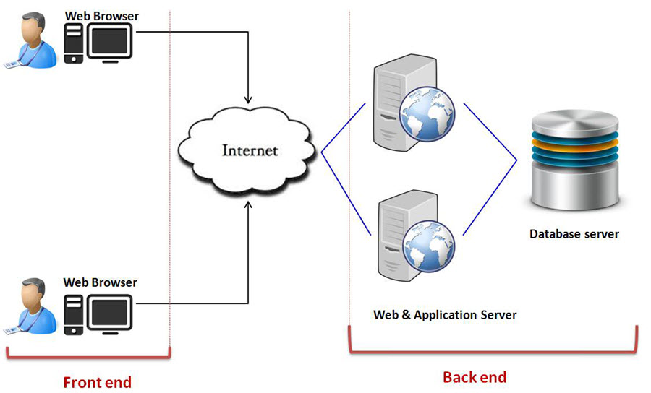

Slide 25
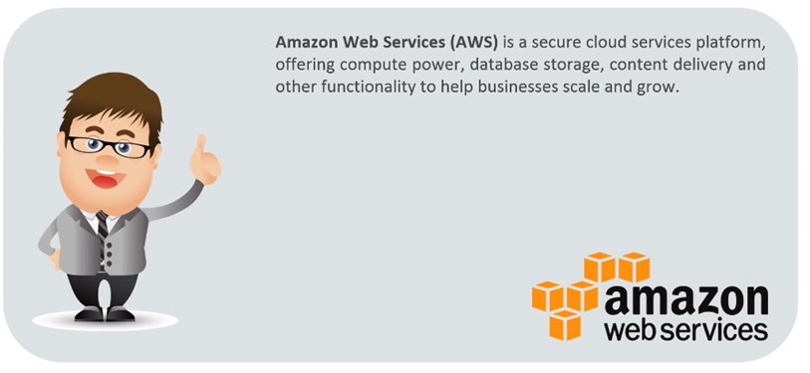
What is AWS?
AWS stands for Amazon Web Service, which is among the most popular cloud platforms. AWS provides developers and organizations with cloud services and helps them stay agile. From multi-million startups to government agencies, many organizations are using AWS. If you want to become a cloud-computing professional, you should learn about AWS. AWS provides a variety of services to its clients.

Slide 26
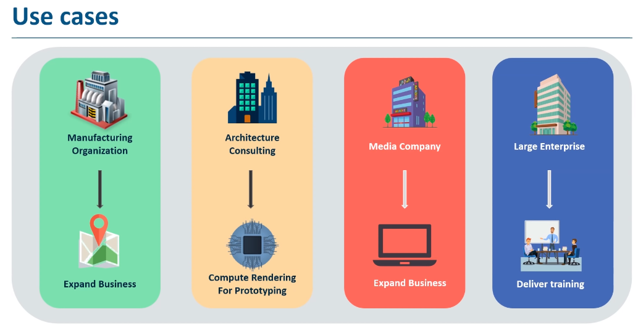

Slide 27
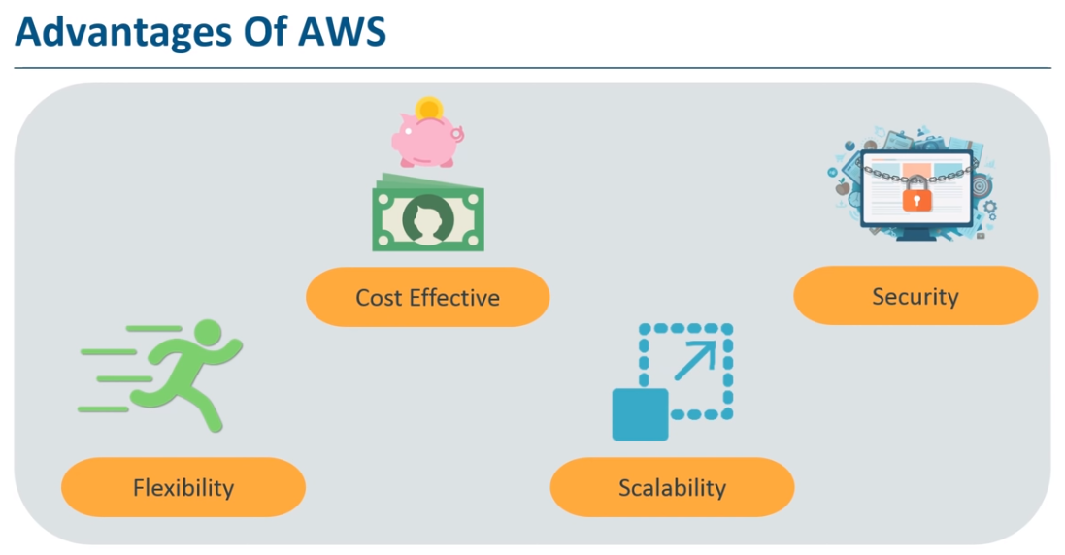

Slide 28


Slide 29
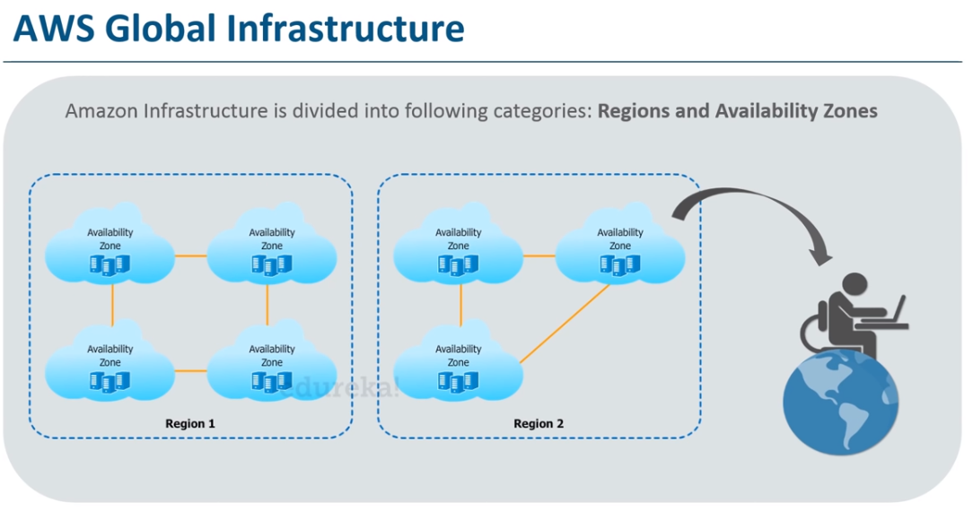

Slide 30
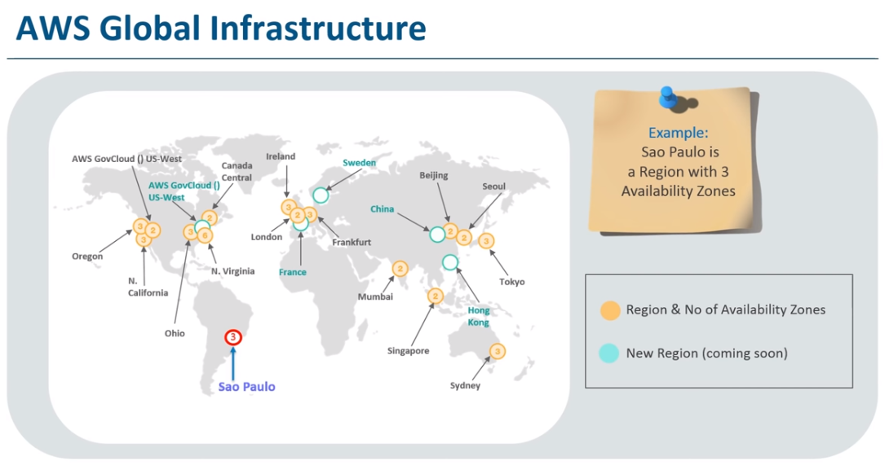

Slide 31
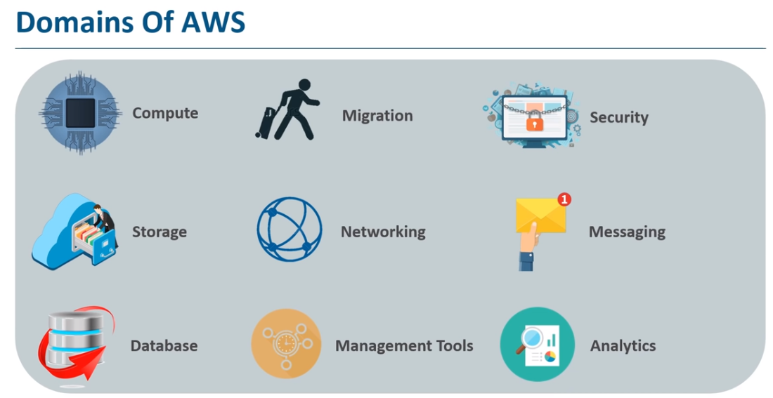

Slide 32
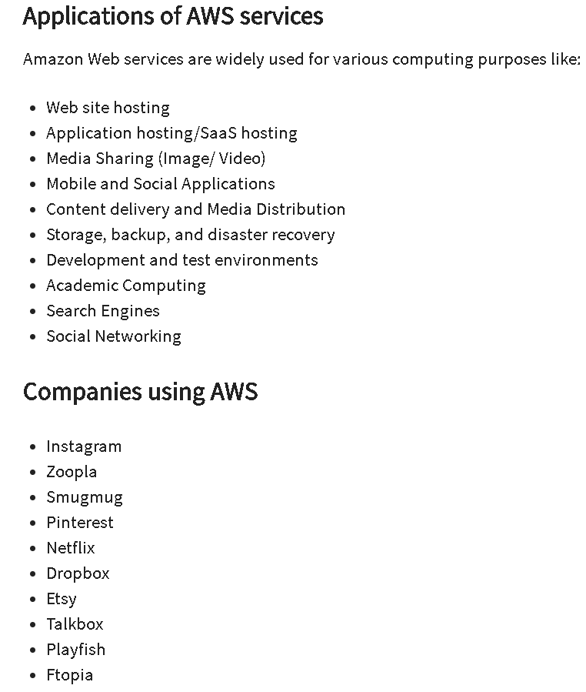

Slide 33
